Slide 1
Managing Big Data
Shouting in Tweets
Faustine Lemaire - s1562290
Roland Balk – s1364448
Véronique Blanchet - s1557866
Z. Saygın Doğu – s1611348

Slide 2
You can go to
http://goo.gl/FECzLK
to see small fonts in data…

Slide 3
What we did
Extracting shouting tweets from the supplied data
Finding Most shouted words in Twitter
Analysis of language of shouting
Analysis of devices used to shout with
Analysis of the time of shouting

Slide 4
How we did it
Extracting shouting tweets : Map reduce
Most shouted words : Map reduce
language of shouting : Pig Latin
Analysis of devices : Pig Latin
Time of shouting : Pig Latin

Slide 5
What is Shouting
The tweets can be all CAPITAL letters.
The text can contain exclamation mark!

Slide 6
Exceptions?
public static final String[] exceptionWords = {
"FIFA",
"RT",
"AUSTRALIA",
"IRAN",
//… all other country names…
//"BRAZIL”,
//"GERMANY
//"NETHERLANDS
"ESPN","FC","RETWEET","BBC","IS","THE","AT","IN","OF","FOR","TO","VS","ARE"
};

Slide 8
Results -Most Shouted Words
Word | Count
WORLD | 1,131,500
CUP | 920,446
BRASIL | 407,282
US | 334,231
FOLLOW | 212,964
TV | 203,098
THIS | 182,293
DE | 181,504
GOAL | 180,092
GO | 157,271

Slide 14
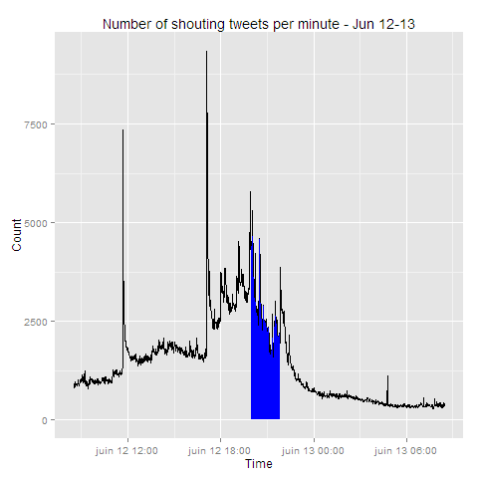
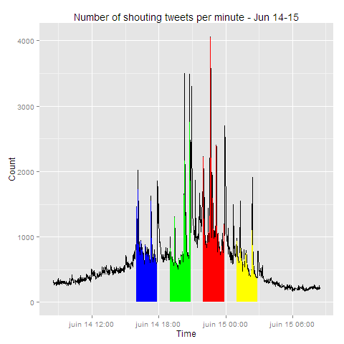
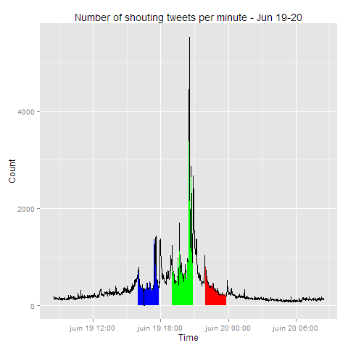
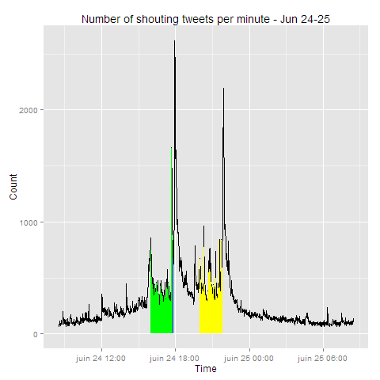
Shouting time – Full Table
Notes:
For the 24th: there are four matches (2 at the same time)

Slide 15

Questions?

